Slide 1
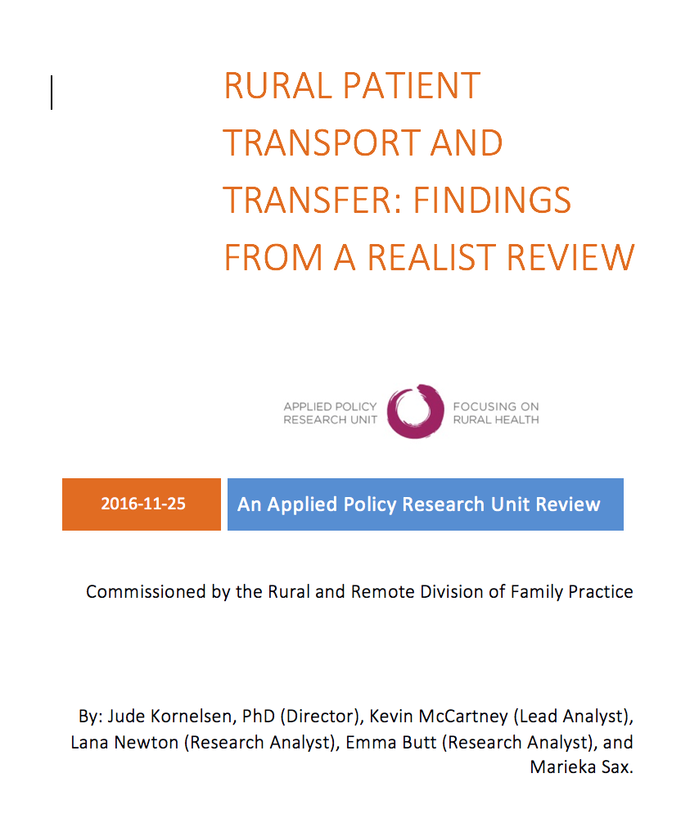
Rural Patient Transfers: Community-based Solutions
The Importance of Community-Based Solutions for MHSU transfers
Jude Kornelsen, PhD Centre for Rural Health Research | Department of Family Practice | UBC

Slide 2
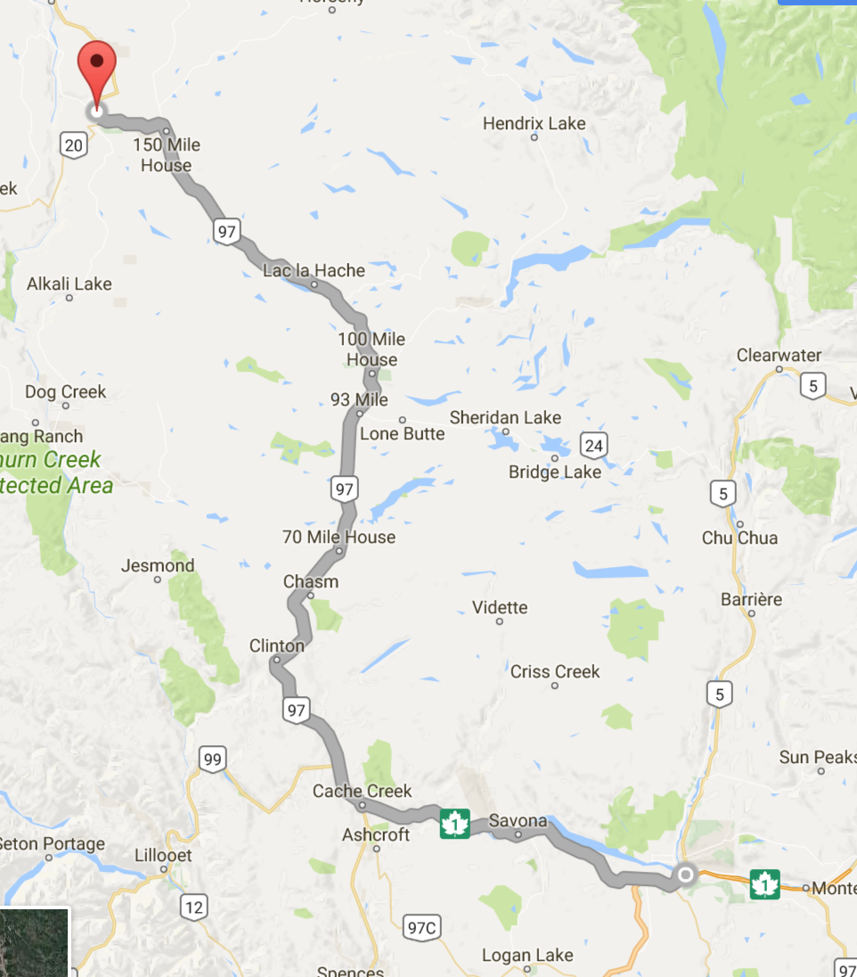
The Problem
Low PCP attachment in some communities (potential for gaps in services)
Difficulty of MHSU patients being accepted into practices
Lack of continuity of care
ED often primary point of access into health care system
Lack of local resources (designated quiet room, MH nurses)
The need for MHSU tranport is frequent in many rural communities due to limited on-site resources
Concerns of transport personnel may include:
Potential for patient self-harm during transport
Potential for harm to others during transport
Potential need interventions en route
Difficulty for patient returning to community
Frequent discharge from referal centre w/o follow-up plan
Williams Lake – Kamloops

Slide 3
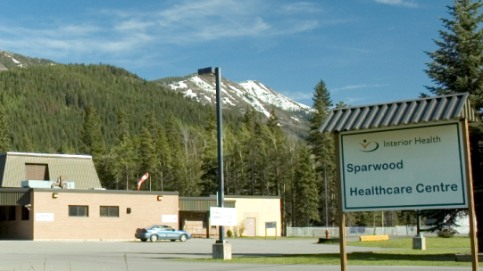
One complex case can overwhelm a rural ED:
One GP
One RN
Limited on-site Lab/Diagnostics

Slide 4
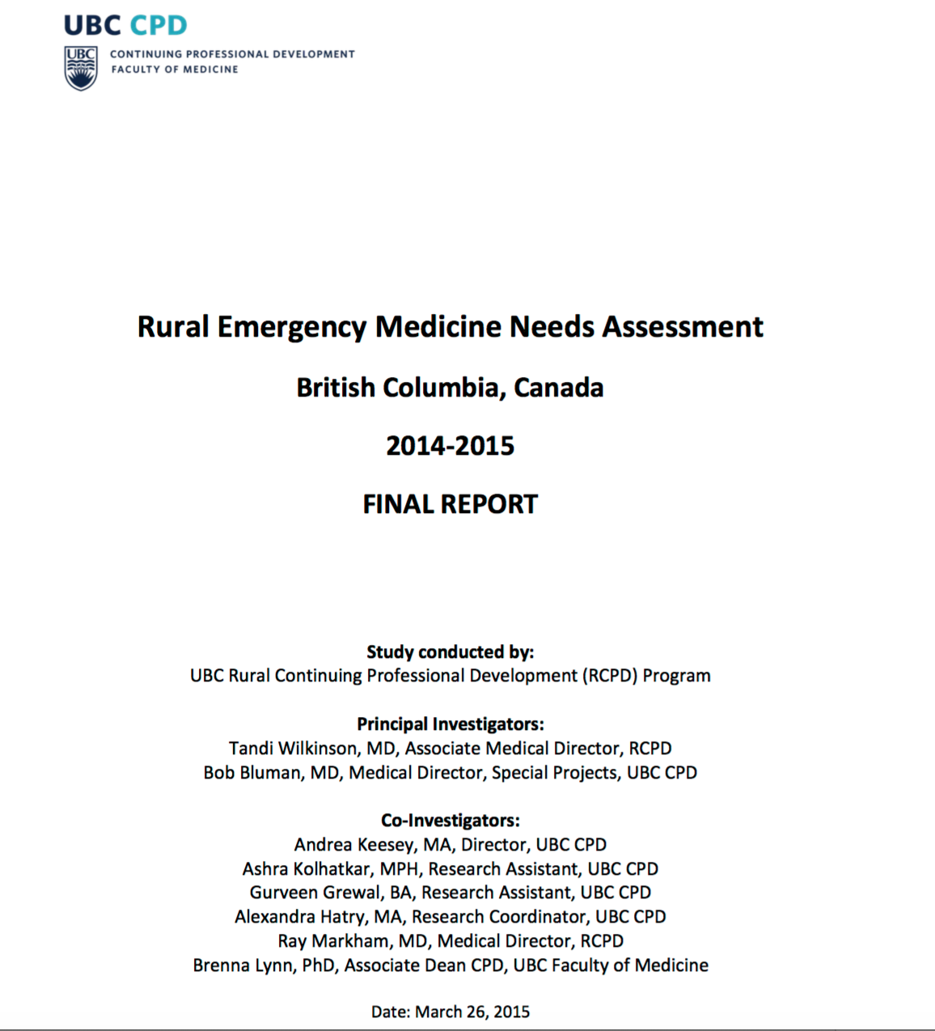
Wilkinson and Bluman (2015) ‘Rural Emergency Needs Assessment’
In-depth focus groups identified a gap in understanding between system-level planning and the realities of skill and knowledge of rural physicians
Consistent with findings from previous field work

Slide 5
Wilkinson and Bluman (2015) ‘Rural Emergency Needs Assessment’
Found systematic exclusion of rural physicians in planning/carrying out patient transport
Despite having in-depth knowledge of patient, geography/local weather/local health resources
Has led to +rural physician frustration

Slide 6
Systematic Realist Review
Commissioned by the Rural and Remote Division of Family Practice with collaboration from IH
“What are the best practice models for transferring medically complex rural patients to secondary/tertiary care?”
Realist review methodology: ‘What works, for whom, under what circumstances, and how?’
151 articles from peer-reviewed literature
Broad search of the grey literature

Slide 7
Patient Transport in BC
Coordinated by BCEHS (oversees BCPTN, TSBC and BCAS)
Responsible for pre-hospital scene support, emergency 911 response, inter-facility transport
Air Ambulance staffed by Critical Care and Infant Transport Team paramedics
Respond to rural and remote by rotary and fixed wing aircraft
Supported in east Kootenays by Alberta’s Shock Trauma Air Rescue Society (STARS)
BCAS is one of the largest emergency transport systems in North America (3,600+ paramedics)
2014-2015: 585 vehicles, 183 ambulance stations, 5 aircraft bases

Slide 8
Thematic Findings
Timing to secondary referral or tertiary care
Equipment and Technology
Health Human Resources
Dispatch and Communications
Governance

Slide 9
Rural MHSU Transport: Case Study
Town of Lillooet, BC (pop. 2300)
Notes:
USE A REAL TRAUMA CASE TO ILLUSTRATE THE CQI CONCEPTS
SOMEWHERE IN BEAUTIFUL REMOTE LOCATION OF IHA

Slide 10
ER Presentation
27 year old man in remote community, 2h8m surface travel to regional referral centre
Accute onset of paranoid psychotic symptoms brought in by RCMP/violent and aggressive
Restrained and given multiple doses of Haldol and Ativan
‘Pink slip’ completed and urgent transport initiated
BLS paramedics EMTs reluctant to take patient
Request patient receive a general anesthetic prior to transport
Local physician reluctant to induce general anesthetic as patient looks like a difficult airway

Slide 11
Complex patient
Limited local resources
Difficulty securing transport
Clinical/Social
Moral/Ethical
Tension
Values guiding solution:
-Concern for safety (of patient, staff, other patients);
-mitigating anxiety
-ED flow

Slide 12
Recommendations
A provincial commitment to facilitating high-level discussions between representatives of BCEHS, regional Health Authorities, the Joint Standing Committee on Rural Issues and provider or professional groups with a rural mandate, including the Doctors of BC, the Rural Coordination Centre of BC, the Rural and Remote Division of Family Practice and other rural Divisions of Family Practice;
Standing Committee on Population Health and Community struck in February with representatives from Doctors of BC, R&R Div of FP, MoH, BCEHS, BCAS, HAs

Slide 13
Recommendations
Recognizing the central role of rural providers in making decisions around
the need for transport;
the severity of need; and
the contextual influencing factors (weather, local availability of transport teams, availability of hospital services such as laboratory and x-ray, limitations on transport such as daylight hours only transport locations, and experience and comfort of the sending provider).

Slide 14
Recommendations
Supporting the capacity of local, interprofessional care teams to maintain care of complex patients through:
Increased Continuing Professional Development (CPD) through local interprofessional education;
The support of on-site critical care and transport teams from regional centres; and real-time telehealth linkages to specialist centres as required.

Slide 15
Recommendations
Improving and streamlining communications between care providers in rural sites and BCEHS
when initiating transfer requests; and
when transport is delayed or diverted

Slide 16
Recommendations
Providing enhanced clinical support (e.g. Telehealth consultation, or in-person nursing support from referral centres) to avoid unnecessary transfers to secondary/tertiary care.

Slide 17
Recommendations
Providing enhanced clinical support (e.g. Telehealth consultation, or in-person nursing support from referral centres) to avoid unnecessary transfers to secondary/tertiary care.

Slide 18
Recommendations
Transport initiation should be streamlined for efficiency, recognizing the critical clinical role of the referring provider both with the transferring patient and in the care of other patients. Referring providers should not be required to repeat a clinical report multiple times to different parties in order to initiate transfer.
Lines of communication back to rural sites should be systematically maintained after transport, alerting the referring site to the course of care and outcome of the transferred patient.

Slide 19
Recommendations
Transport initiation should be streamlined for efficiency, recognizing the critical clinical role of the referring provider both with the transferring patient and in the care of other patients. Referring providers should not be required to repeat a clinical report multiple times to different parties in order to initiate transfer.
Lines of communication back to rural sites should be systematically maintained after transport, alerting the referring site to the course of care and outcome of the transferred patient.

